Slide 1

All Hands on Deck Update
CART
Conservation Assessment Ranking Tool
May 2019

Slide 2
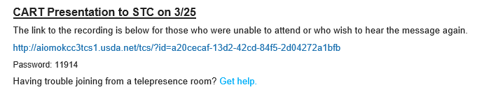
CART presentation recordings
USDA Connect: https://connections.usda.gov/wikis/home?lang=en-us#!/wiki/Wbf1a820869d2_4a3f_b5e4_008fd4368c03
Workflow
Geospatial Capabilities
Assessment Process with Examples
Ranking Configuration
Q&As

Slide 3
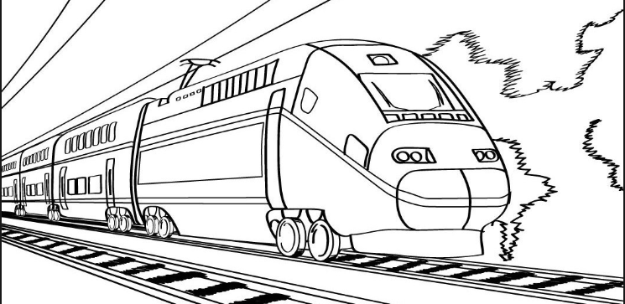
CART Development on pace!
Conservation Train
PI 1
Nov 2018
PI 2
Jan 2019
PI 3
April 2019
PI 4
June 2019
PI 5
Aug 2019
10/01/18
09/30/19

Slide 4
Three Product Development Teams
Objectives from PI#3
Ranking Team
NPMs may create & Complete National template
SPMs may create Ranking Pools & Adjust within Template Constraints
SPMs may select configuration questions for ranking pools
Assessment Team
RCs Identification
Land Unit Inventory of existing conditions
Select Existing Practices
Calculate Assessment points
Configuration Team
Resource Concerns Component Points (Updated NRT schema)
Publish Display Group from config to NPAD
Set Standard Threshold by Resource Concerns Component

Slide 5
User Acceptance Testing Environment
Coming soon!

Slide 6
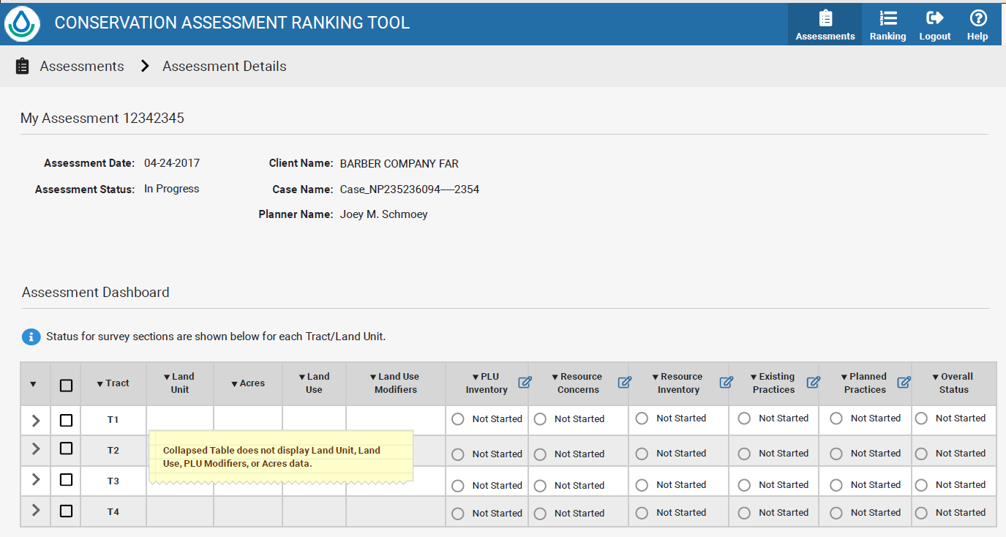

Slide 7
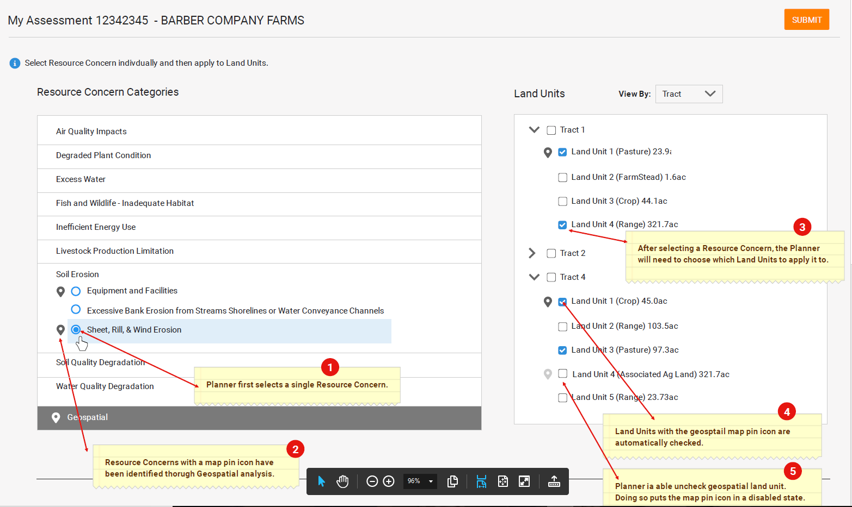

Slide 8
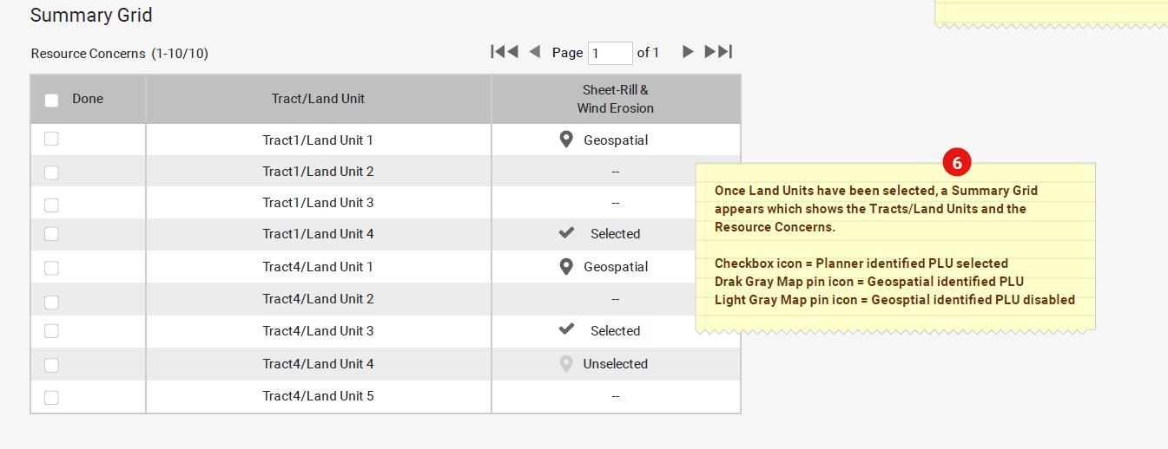

Slide 9
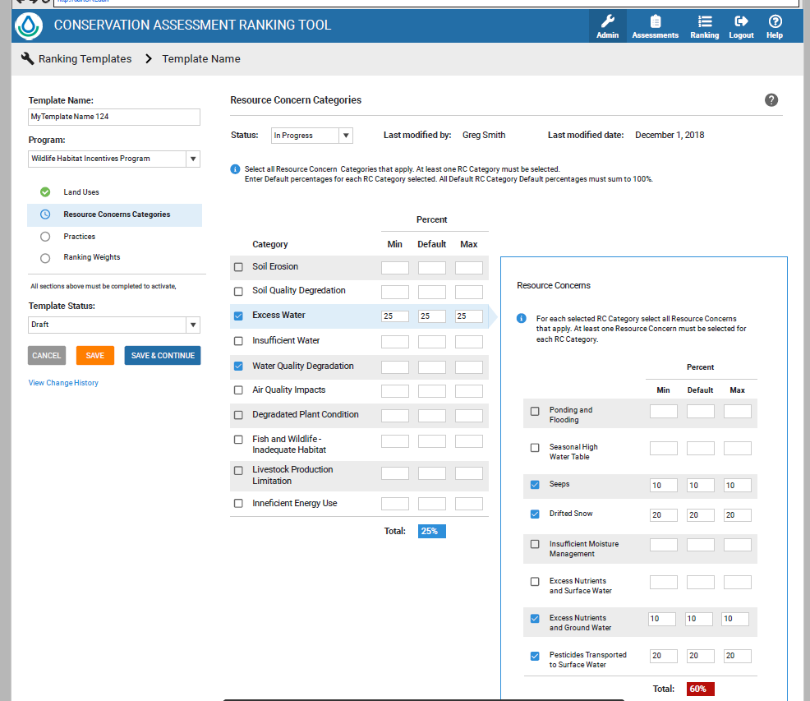

Slide 10

National Bulletin 440-19-9 Review of CART Resource Concern Assessment Document
All employees had the authority to comment during a 45 day window
SharePoint interface was created to collect comments
Comment period closed on April 19th
1856 distinct comments of various types and level of detail received!

Slide 11
1856 Comments – Now What?
Feedback Team
Item | Action | Target
1 | Compile Questions and Distribute to Team Leads | May 3
2 | Compile master copy of questions and store on Sharepoint | May 3
3 | Create a FAQ document with response to generalized Questions | June 5
4 | Set-up Weekly Call in meeting for Team Leads to have open discussion | Weekly
Team Leads
Item | Action | Target
5 | Review Feedback and provide generalized questions and responses to Feedback Team | May 31
6 | Work with team to provide revised questions and points as appropriate | May 31
7 | Work with team to populate Points for Practices table | May 31
Next Steps
Item | Action | Target
8 | CART UAT Site, portions will go active this week. More info in weekly meeting | Weekly
9 | Assessment Revisions worked into testing site for version 1.0 changes Backlog list of version 2.0 changes started | June 30
10 | Second Round of Feedback with testing environment | July 15

Slide 12
Upcoming – Training
How to Develop a Ranking Pool in CART
Audience: STCs, ASTCs for Programs, ASTCs for Easements, State Program staff
Where: VTC, Skype meeting, (recorded)
When: May 21st 1-3pm Eastern
*official notification will be sent out in the near future

Slide 13
Outline of Training
Prepare
Utilize Locally Led Process for Input
Strategic Ranking Pools
Review Priorities and Questions
Geospatial Supporting Layers
CART Tool
Choose a Program Template
Configure Ranking Pool
Set Boundary and Filter Criteria
Applicability Questions
Resource Priority Questions
Programmatic Questions
Publish Ranking Pool

Slide 14
More Training
July Mission Implementation (SRC/Programs Meeting)
August Farm Bill Implementation
Sept 16-20th CD 2.3/CART 1.0 Train the Trainer
Sept 30-Oct 4th

Slide 15
Questions?

